Slide 1


Empowering Women in STEM: Breaking Barriers and Building Bridges
Women's involvement in STEM is essential for society's continued progress. However, gender bias and other challenges have slowed progress. Through mentorship, we can help women shatter these obstacles.
TEAM NAME : BACK-END BATTALION
TEAM MEMBERS: GURMEHAR SINGH
PARMINDER SINGH
PRIYANSHI BANGIA

Slide 2



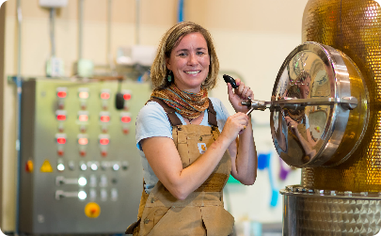
Why Empower Women in STEM?
More Diversity
Role Models
Innovation
Empowering women in STEM creates a more diverse and inclusive workforce.
Girls need to see women in STEM fields and be inspired to follow in their footsteps.
Research shows that gender diversity leads to increased innovation and creativity in STEM.

Slide 3
The Challenges Women Face in STEM
Gender Bias
Lack of Support
Women are not always given equal opportunities due to bias in hiring, promotion, and salary.
It's often difficult for women in STEM to find strong support systems and mentors.
Work-Life Balance
Imposter Syndrome
Many women struggle to balance their careers in STEM with their personal and family lives.
Women may feel like they don't belong in STEM and question their abilities.

Slide 4
Mentorship: An Effective Solution
1
Empowerment
Mentorship can provide women with the knowledge, skills, and confidence to succeed in STEM.
Networking
2
Mentorship creates important networking opportunities for women in STEM.
3
Retention
Mentorship can increase retention rates of women in STEM fields.

Slide 5



Creating a Mentorship Network
Diverse Participants
Structured Programs
Experienced Leaders
Successful mentorship networks are inclusive and composed of diverse participants.
Effective mentorship programs provide structure, guidelines, and goals.
Experienced leaders are critical in building and running effective mentorship programs.

Slide 6
Examples of Successful Mentorship Programs
Women in Technology International
The Athena SWAN Charter
Girls Who Code
A nonprofit that provides young girls with coding education and mentorship opportunities.
A network that empowers women in technology through training, networking, and mentoring.
A UK-based initiative that recognizes and supports institutions that promote gender equality in STEM.

Slide 7



Success Stories
Dr. Tiye Landers
Jessica Lee
Women in Science
Thanks to mentorship, Dr. Landers is now an accomplished engineer and leader.
Mentors help Jessica Lee navigate through challenges and shatter the glass ceiling.
The Women in Science program connects students with women mentors, inspiring them to enter STEM fields.

Slide 8
The Future of Women Empowerment in STEM Mentorship
1
Innovative Programs
Developing new and innovative mentorship programs that cater to the needs of women in STEM.
Improved Research
2
Conducting research on the effectiveness of mentorship and gathering data to improve program design.
3
Expanded Network
Expanding our mentorship network to make a greater impact on empowering women in STEM.

Slide 9
BUISNESS MODEL
This model contains free live demos and paid courses for all the people who want to learn about stem ( science , engineering , tech, maths)
This model contains 4 demo classes and if the person likes the content they can upgrade the course to 3 months basic course
This expenses of this business will contain business advertisement and collab with ngos and more other things
.

